Slide 1
Before Class Starts (OPEN BOOK!)
Chapter 2 - What did the statue in Nebuchadnezzar’s dream represent?
What historical fulfillment are we told of specifically in that chapter?
Chapter 7 – What did the beasts of Daniel’s vision represent?
What correlates to the stone of chapter 2?
Chapter 8 – What do the ram and goat represent?
Which element of the vision receives the most attention in the text?

Slide 2
Book of Daniel Class 10 – Chapter 9 Winter 2023
Daniel’s Prayer – Who was this prayer written for? When was it written?
Daniel, Remnant, Medes, other Israelite leaders, us?

Slide 3
Daniel – Rough Outline
Style
Ch 1-6: Story
Ch 7-13: Vision
2. The King’s Dream
7. Daniel’s Dream
3. The Fiery Furnace
6. The Lion’s Den
4. Nebuchadnezzar’s Pride
5. Belshazzar’s Pride
8. Daniel’s 2nd Vision
1. Recruited to Serve in Babylon
9. Daniel’s Prayer
10-12. Daniel’s 3rd Vision
HEBREW
ARAMAIC
HEBREW

Slide 4
The Book of Daniel (Structure)
Style:
Ch. 1-6: Story
Ch. 7-12: Vision
Ch. 1 Hebrew
Ch. 2-7
Aramaic
Ch. 8-12
Hebrew
Language:
Prologue
God rules in the kingdoms of man.
God preserves His sacred people.
Theme:
We are in this section now

Slide 5
Visions of Coming Kingdoms
Chapter 2
Statue
Chapter 7
Beasts
Chapter 8
Animals
Head of Gold
Babylon
Lion with Wings
Chest of Silver
Medo-Persian
Bear Up on One Side
Medo-Persian
Ram with Two Horns
Thighs of Bronze
Leopard with Wings
Greece
Goat with Speed
Greece
Feet of Iron/Clay
Terrible Beast
Stone
Son of Man

Slide 6
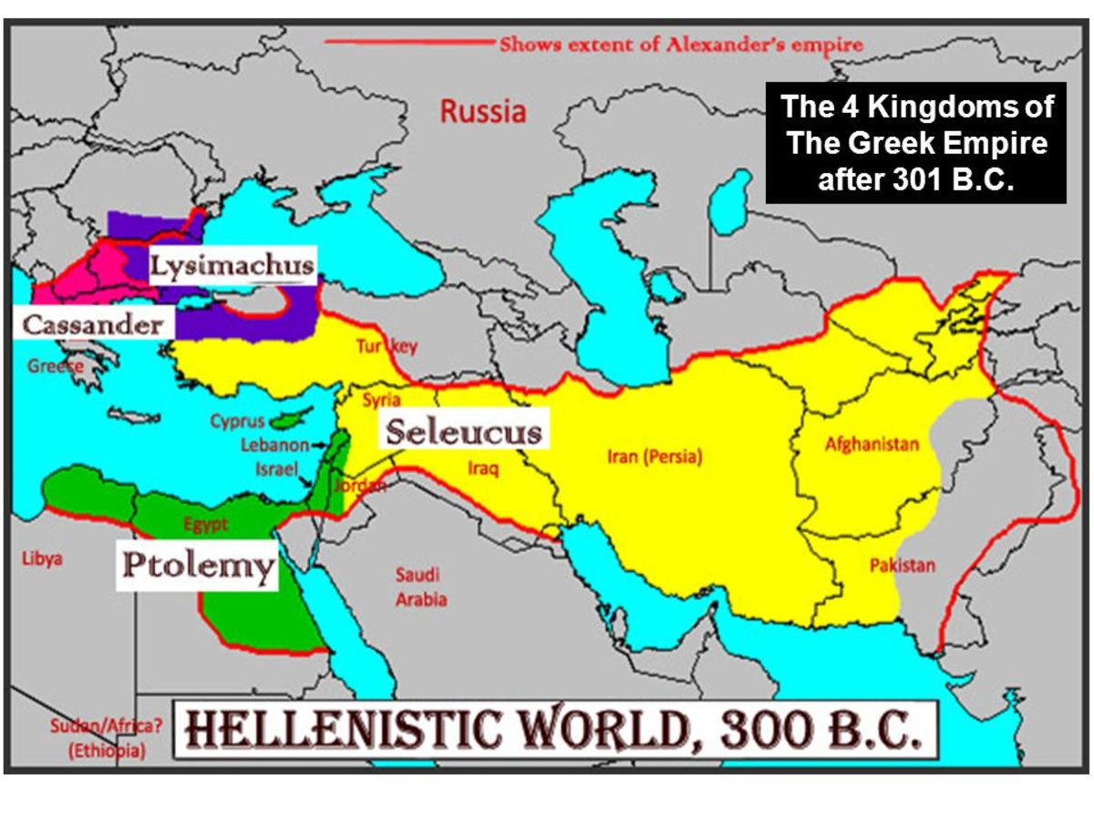

Slide 7
The Book of Daniel Daniel 9 (v. 1-19)
Let’s read the text together…

Slide 8
Daniel 9 – The Prayer (v. 1-19)
What event prompted Daniel to pray this prayer?
What was the prayer all about?
What impresses you about Daniel’s prayer?
What lessons should we learn for our prayers?
70 years (per Jeremiah) were up. Also Babylon is fallen.
Confession of Israel’s sin, pleading with God to remember His promises and rescue His people.
Class answers – sincerity, deep trust, what else?
Class answers - Do we believe that God can answer prayers or not?

Slide 9
Daniel 9 – Daniel’s Prayer
Important Passages for Context
Exodus 34:6-7
(Leviticus 26:27-45)
2 Chronicles 36:20-21
Jeremiah 25:8-14
Jeremiah 29:1-14

Slide 10
Daniel 9 (v. 20-27)
Let’s read the text together…

Slide 11
Daniel 9 – God’s Response (v. 20-27)
How long did Daniel have to wait for a response?
Who brought the response to Daniel? For what purpose?
What is the key message to the “70 weeks” passage?
What message does this story send to a broader (non-Hebrew) audience? – Discuss!
v. 20 – while I was speaking
v. 22 – Gabriel – for insight and understanding – God loves him
v. 24-27 - God’s plan to deal with the real problem (sin) in the Messiah
God is in control!

Slide 12
70 Weeks – high level overview
“Seventy weeks are decreed…” (9:24-27)
About your people and your holy city
Finish transgression (see 8:23; Gen. 15:16)
Put an end to (“seal”) sin
Atone for iniquity
Bring in everlasting righteousness (Is.53:11)
Seal vision and prophecy
Anoint a most holy _________.
God’s plan to deal with the real problem (sin) in the Messiah

Slide 13
Seventy Weeks in Daniel 9:24-27
Word to Restore Jerusalem (538 BC; see Ezra 1:1)
7 weeks (49* years)
Jerusalem rebuilt/restored
Zerubbabel,
Ezra, Nehemiah
62 weeks (440* years)
“times of distress”
Intertestamental Period (see ch.8,11)
Final week (7* years)
Messiah cut off
City/temple destroyed
Firm covenant
Stop to sacrifice (3.5 days)
Abomination of Desolation
Desolator destroyed
Could include:
Crucifixion of Jesus
Roman invasion
New Covenant
Religious persecution
Destruction of Jeru.
Roman downfall
70 weeks (490* years)
Messiah
The Last Days, Days of Messiah
Final Sabbath, Jubilee

Slide 14
What can we learn from Daniel 9:20-27?
What do you think we learn from all of this?
God’s plan beyond what we understand
Human sin is the problem, God’s plan is to deal with it completely
In Jesus Christ, God has ushered in the eternal Sabbath and ultimate Jubilee

Slide 15
The Book of Daniel
Homework: Chapter 10-11 (War and Kings – and The Man)

Slide 16
Daniel: Class Schedule
# | Date | Class | Teacher
1 | Sun 12/3 | Class Introduction & Background | Robert McDonald
2 | Sun. 12/10 | Chapter 1 | Robert McDonald
3 | Sun. 12/17 | Chapter 2 | H.E. Jenkins
4 | Sun. 12/24 | Chapter 3 | Robert McDonald
5 | Sun. 12/31 | Chapter 4 | H.E. Jenkins
6 | Sun. 1/7 | Chapter 5 | H.E. Jenkins
7 | Sun. 1/14 | Chapter 6 | Robert McDonald
8 | Sun. 1/21 | Chapter 7 | H.E. Jenkins
9 | Sun 1/28 | Chapter 8 | H.E. Jenkins
10 | Sun. 2/4 | Chapter 9 | Robert McDonald
11 | Sun. 2/11 | Chapter 10-11 | Robert McDonald
12 | Sun. 2/18 | Chapter 12 | H.E. Jenkins
13 | Sun. 2/25 | Summary and Themes | H.E. Jenkins

